Slide 1
Building a Better Battery with Data Driven Techniques
Under the Supervision of
Dr. B. Pattabhi Ramaiah
Submitted by
Prateek Gandhi
MTech, Mechanical Systems Design
IIT Bhubaneswar
14-09-2021

Slide 2
Objective
To enter the unknown part of material science where we are combining, what we know from the conventional approaches, with these new ideas from big data and machine learning to accelerate the current work of search for materials for solid electrolytes in the lithium-ion batteries.

Slide 3
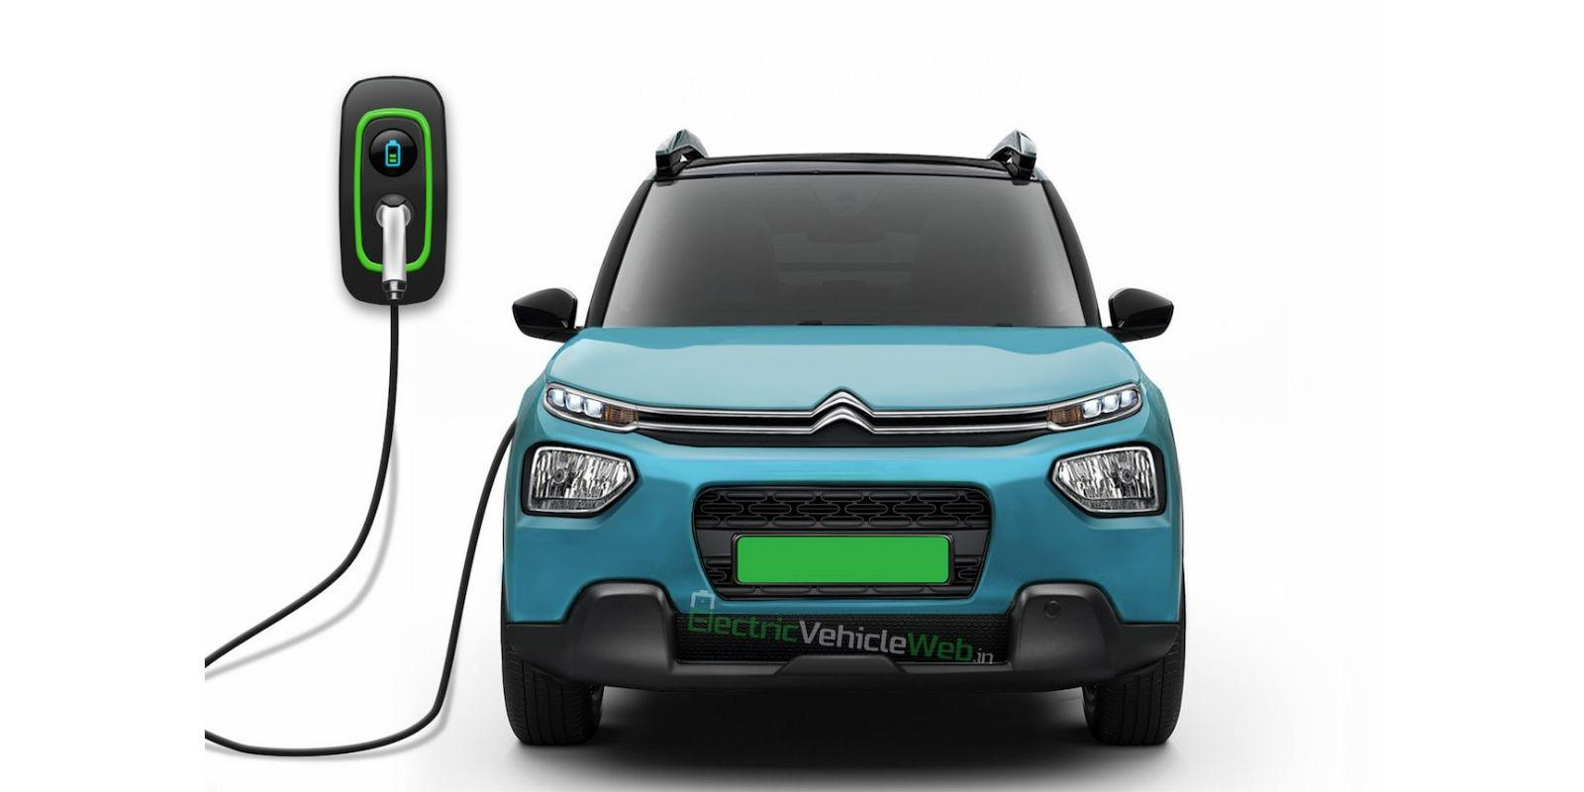
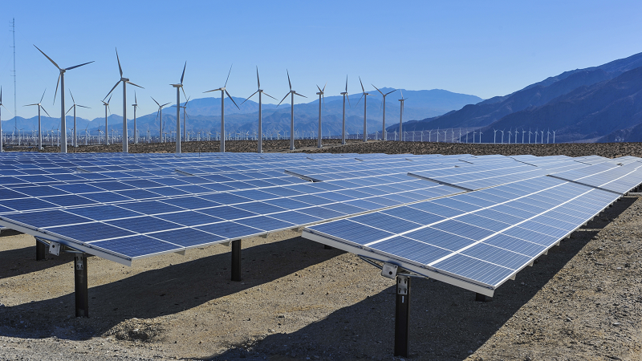

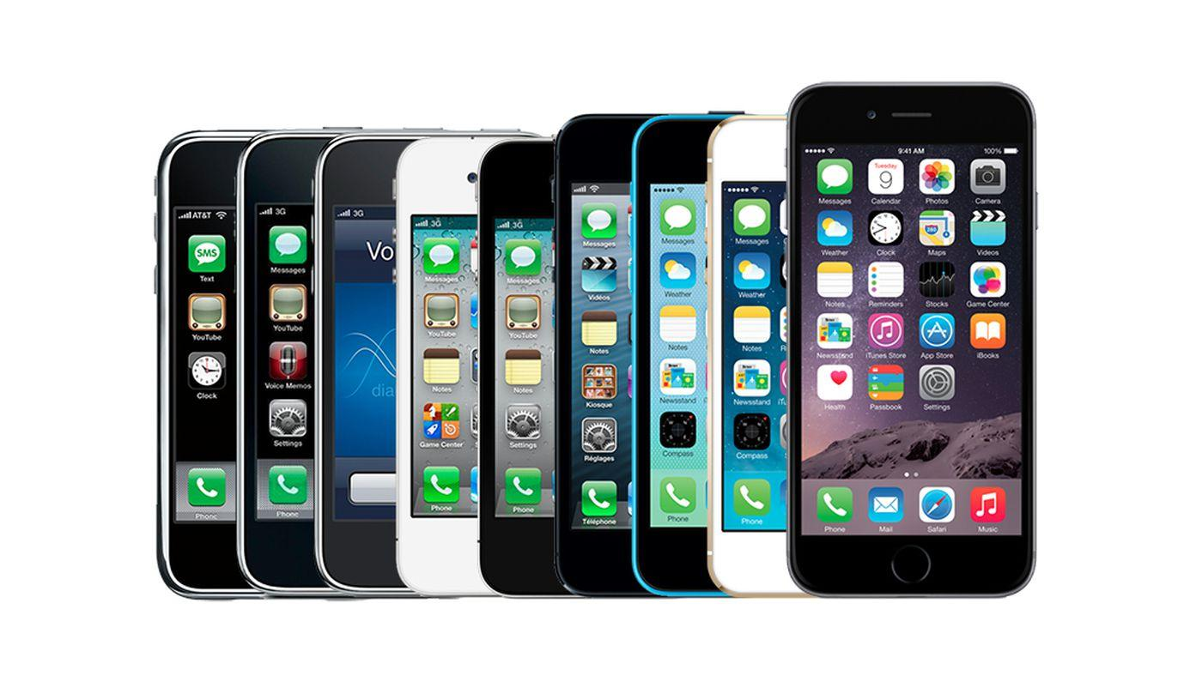
Li-ion batteries have enabled major innovations in energy
Automotive^{[1]}
Renewable grid^{[2]}
Drones^{[3]}
Mobiles^{[4]}
[1] https://www.citroen.in/
[2] https://www.massnetcomms.org/software-to-simplify-solar-farm-design/
[3] https://www.ga-asi.com/remotely-piloted-aircraft/mq-9a
[4] https://www.apple.com/in/
14-09-2021
Notes:
I don't think I have to
really convince you of the
importance of energy storage I'm sure
we're all aware of you know how
Important energy storage is
lithium-ion
batteries in particular have enabled
major innovation across the spectrum of
energy technologies
course we all know about automotive with
Tesla and you know other electric
vehicles putting renewables on the grid
batteries have been used for your load
balancing there's been some recent
deployments down in Southern California
for this now even their company is
thinking about you know heavy equipment
being powered by batteries like
airplanes and of course you know mobile
electronics so they're they kind of run
the gamut of powering all kinds of
technologies

Slide 4
...but today’s Li-ion batteries still face many challenges
Safety
Energy Density
Cost
Cycle Life
14-09-2021
Notes:
but we can't get around the
fact that these batteries aren't perfect
there are sort of four main
areas where technology can get a lot
better safety of course is you know
should be the top priority safety and
batteries needs to be unquestioned and I
think it's very questioned right now so
that's that something has to be improved
energy density always needs to come up
cost always needs to come down and cycle
life needs to improve so especially if
you start thinking about you know
electric vehicles where you want to be
able to drive for 10 or 20 years without
replacing the battery
you need to have you know
really excellent cycle life from these
devices

Slide 5
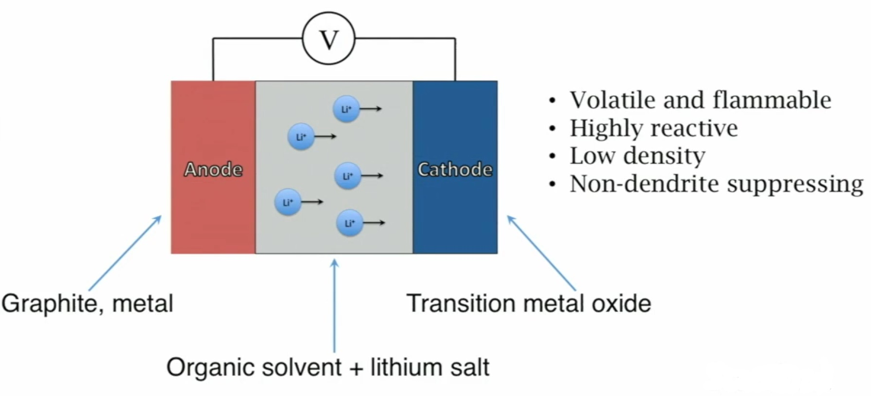
A major problem worth solving: Liquid Electrolytes
Figure: A schematic of a conventional battery^{[5]}
[5] Sendek, Austin D., Qian Yang, Ekin D. Cubuk, Karel-Alexander N. Duerloo, Yi Cui, and Evan J. Reed. "Holistic computational structure screening of more than 12000 candidates for solid lithium-ion conductor materials." Energy & Environmental Science 10, no. 1 (2017): 306-320.
14-09-2021
Notes:
so when we think about ways
that we can improve these these metrics
one of the one of the aspects of battery
technology that is kind of at the heart
of a lot of these problems are the
electrolytes so this is a schematic of
our battery we have an anode and a
cathode those are your two terminals and
then you have this electrolyte in the
middle that separates the two and it
mediates the transport of lithium back
and forth as you charge and discharge
the battery and so in commercialised
cells and you know the cells in your
phone in your laptop these are organic
solvents so they are you know they're
liquids we can't use aqueous or
water-based solvents because lithium
reacts with water so we have to use
these you know they work they work well
by most accounts that your lithium flows
through them
pretty quickly
they're
manufactured at scale but you know
organic solvents are a problem you know
other organic solvents you might know of
are like gasoline
you know nail polish remover they're
very flammable so if you were to
overheat the battery or puncture it or
you know catch it on fire that's going
to be it would be a huge issue but aside
from that you know they're also not
great because
very reactive so you can't put a large
voltage across a liquid electrolyte
because it'll start to vaporize it'll
start to react and break down they are
also low density so you can't make
really small devices and they don't
suppress dendrites and and dendrite
growth is one of the the main causes of
early battery death so these don't
really do much for that problem

Slide 6
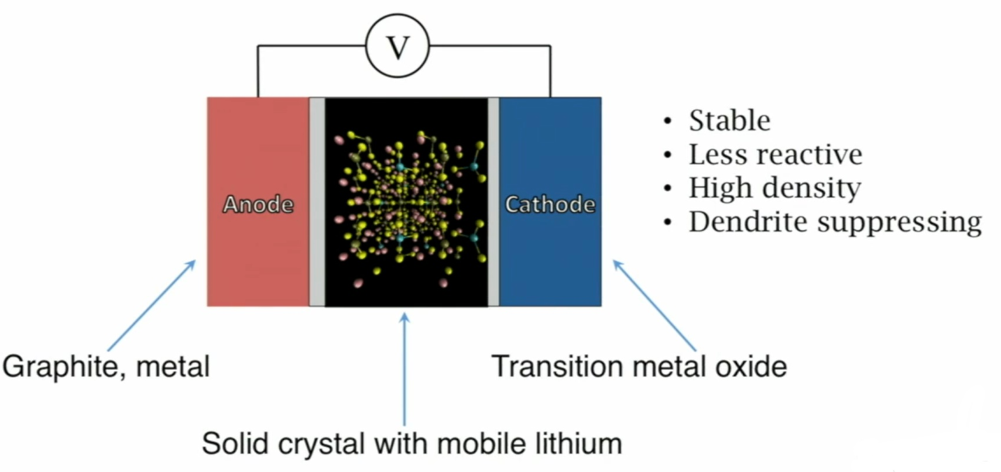
A major problem worth solving: Liquid Electrolytes
Figure: A schematic of a solid electrolyte battery^{[5]}
[5] Sendek, Austin D., Qian Yang, Ekin D. Cubuk, Karel-Alexander N. Duerloo, Yi Cui, and Evan J. Reed. "Holistic computational structure screening of more than 12000 candidates for solid lithium-ion conductor materials." Energy & Environmental Science 10, no. 1 (2017): 306-320.
14-09-2021
Notes:
so what
we want to do in our research is we want
to replace that liquid with the solid
material that can do the same job that
that hopefully has all the benefits of
the liquids without these major
drawbacks
so solids are just sort of inherently
more stable and less reactive their
higher density so you can potentially
make smaller devices and they're very
rigid so they can suppress this growth
growth of dendrites and potentially lead
to increased of cycle life so so solids
can can really help us on all four of
these these metrics that we originally
discussed so this is all to really to
convince you that solid electrolytes are
a really fascinating and I think very
promising way to go to improve on
battery technology

Slide 7
Solid electrolytes are a promising route to improvement
Safety
Non flammable, stable
Energy Density
Higher voltages
Cost
Abundant materials
Cycle Life
Dendrite suppression
14-09-2021

Slide 8
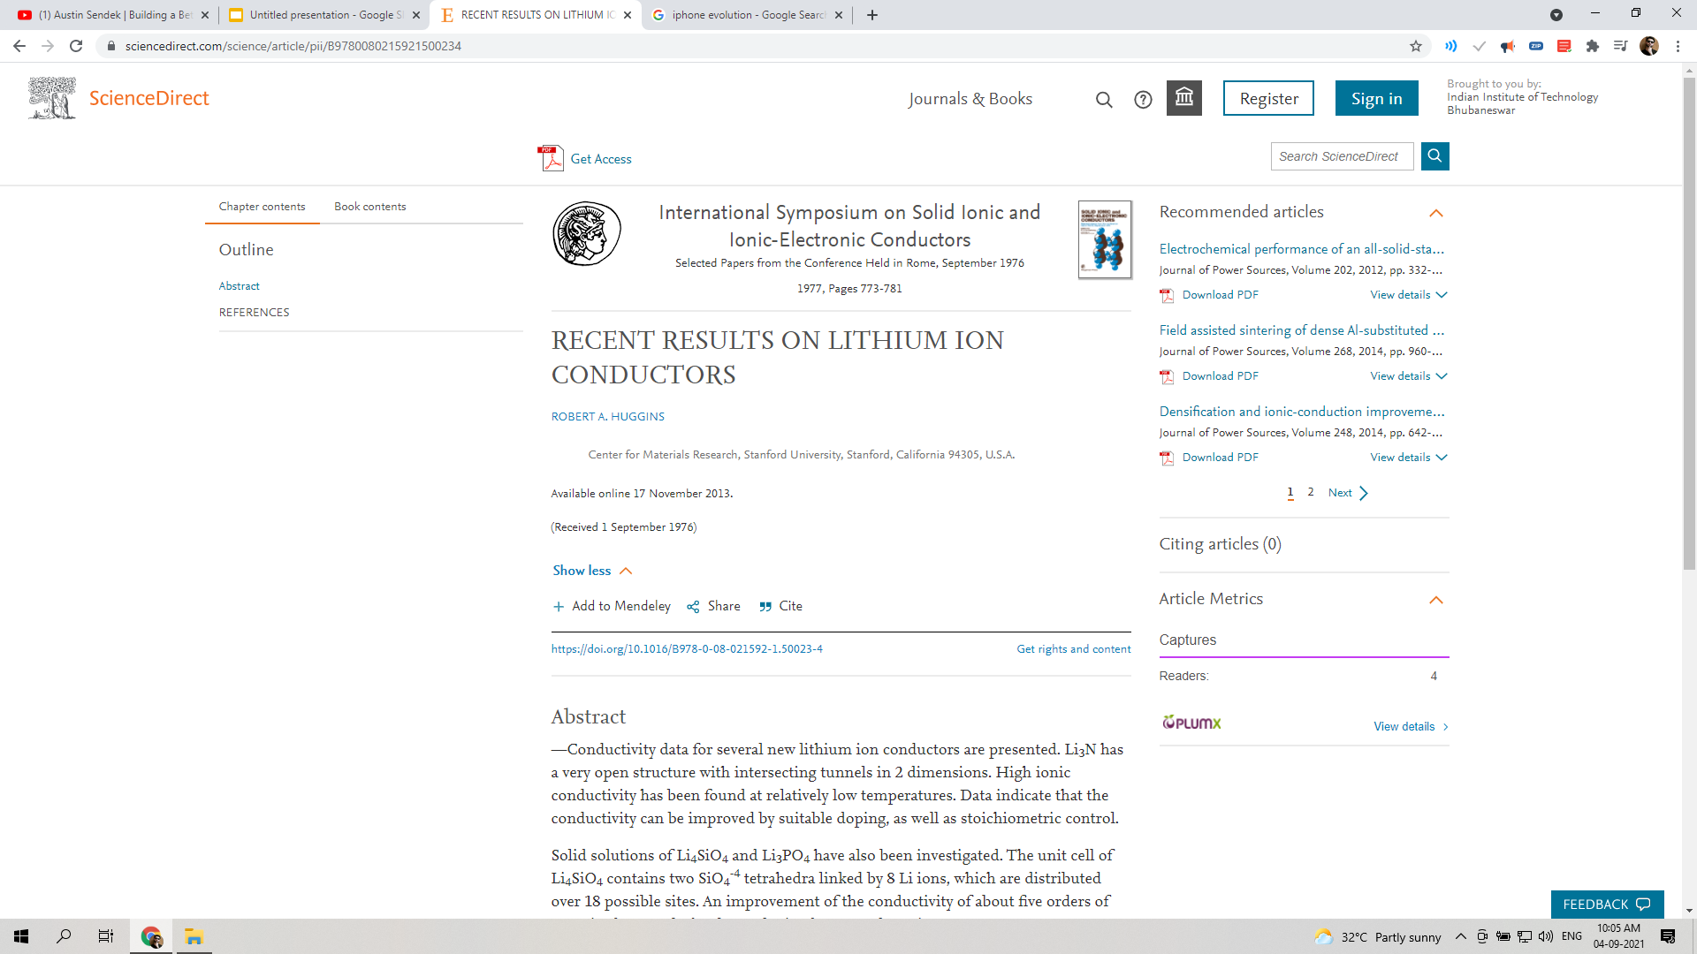
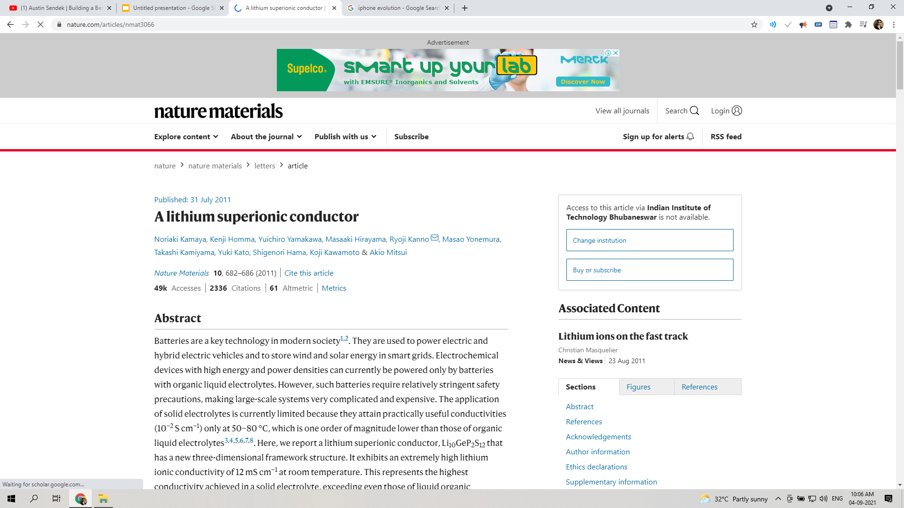
Challenge: trial-and-error search for candidates satisfying many conditions
14-09-2021
Notes:
so the other
question is
well hey if this is so great then why
why doesn't it work why haven't why are
we doing this now and the short answer
is that we've been trying to do this for
a long time and we haven't really been
very successful so I think nothing
really illustrates that better than the
juxtaposition of these two papers this
is a review a review not a paper a
review on recent results on lithium ion
conductors from 1976 and then this is a
paper from I think 2011 one new material
was found and it was a nature paper so
these these are like 35 years apart you
know by now it's over 40 years and we're
still working on this problem so why is
this so hard

Slide 9
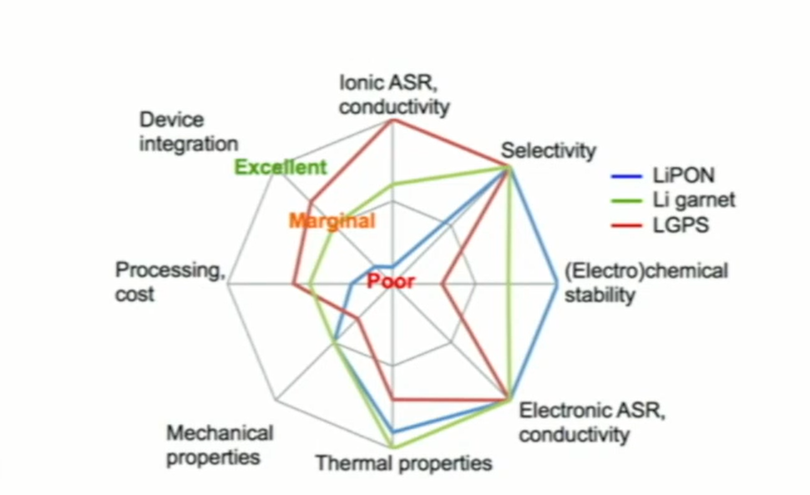
Challenge: trial-and-error search for candidates satisfying many conditions
Figure: Parameters, a candidate material should satisfy^{[6]}
[6] Wurzelmann, Sam. "Advanced Research Projects Agency-Energy (ARPA-E): Innovation through the US Department of Energy." Center for Climate and Energy Solutions (2012).
14-09-2021
Notes:
well solid electrolyte materials that
that work in batteries have to satisfy a
bunch of criteria at the same time and
this this plot here from arpa-e I think
really illustrates that well so there's
you know these sort of conductivity and
stability
things like processing ease where you're
thinking about like a manufacturing
scale so there's just there's a lot of a
lot of requirements that you have to to
meet at once and if we're searching for
promising materials based on trial and
error just mathematically you can see
that you know if you draw material at
random what are the odds that you're
gonna satisfy ten criteria at once which
are your probably hard to satisfy just
one of them
but if you're trying to satisfy ten at
once it's just gonna be a you know a lot
harder to do mathematically yours gonna
have to do a lot more trial and error
Lithium phosphorus oxynitride (LiPON)
Li7La3Zr2O12
Li10GeP2S12

Slide 10
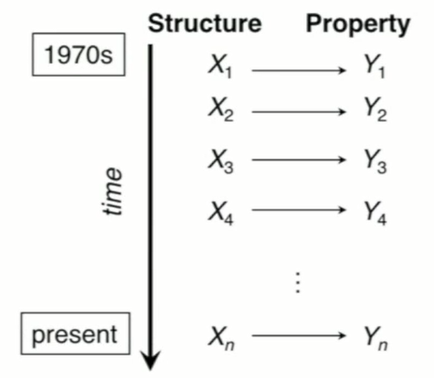
Existing discovery efforts are driven by trial and error
This can be formulated as a supervised learning problem:
f(X) = Y
f(structure) = property
Can we learn effectively from the data we have already generated?
Machine Learning may improve success rate beyond trial-and-error!
Figure: XY pairs where X is a material that was picked by a random guess and Y is the property which was being measured [5]
[5] Sendek, Austin D., Qian Yang, Ekin D. Cubuk, Karel-Alexander N. Duerloo, Yi Cui, and Evan J. Reed. "Holistic computational structure screening of more than 12000 candidates for solid lithium-ion conductor materials." Energy & Environmental Science 10, no. 1 (2017): 306-320.
14-09-2021
Notes:
Predicting ionic conductivity is hard. You have to make the material and test it.
if we kind of back up and and and look
at how things have gone you know
philosophically from the 70s to present
we have this timeline where we take a
structure at a material structure we'll
call it x1 if we go into the lab and we
measure the property that we want call
it y1
maybe it's ionic conductivity if it's
good it's good if it's bad it's bad you
know it's usually not great so we go
take another one x2 and then we measure
y2 and we continue this basically n
times to present hoping that we're gonna
find the right one and we haven't really
found the best one but we have generated
a ton of data and a ton of wisdom here a
ton of XY pairs and so what we want to
do is is reformulate this as you know
let's not just keep trying things but
let's take this data that's already out
there and let's reformulate this as a
problem of super supervised learning
where we are taking the X as we know and
the Y's we know and looking for this
function f which can map between the two
of them and in the material science
world this is a structure property
relationship
so the question driving us is can we
learn effectively from the from the data
that we've already generated without
having to generate a whole bunch more
and machine learning is
it's really the way for us to do that to
hopefully go beyond trial and error

Slide 11
Brute force experimental and computational searches
3 days/candidate material x 12,000 candidates = 100 years
+ the billions (infinite) more materials in the universe and all their combinations = difficult, unmanageable and complex[5]
Alternative approach: Use ML to make a rapidly computational model
[5] Sendek, Austin D., Qian Yang, Ekin D. Cubuk, Karel-Alexander N. Duerloo, Yi Cui, and Evan J. Reed. "Holistic computational structure screening of more than 12000 candidates for solid lithium-ion conductor materials." Energy & Environmental Science 10, no. 1 (2017): 306-320.
14-09-2021
Notes:
and
just to give you a sense of the time
scales involved here as further
motivation if we say I think this is a
liberal estimate if we say it's three
days for to assess a let's say
connectivity and a candidate material
probably more like two weeks or three
weeks but let's just say it's three days
there's 12,000 known lithium containing
compounds out there so that's 100 year
PhD right there just to get through all
of those but then you
know when we think about the fact that
material space is really infinite
because there's all kinds of different
combinations of elements we all are
close to infinite then this becomes just
totally intractable you know there's
there's there's millions of billions of
candidate materials that you could think
of out there so we don't want to just
compute 12,000 things we want to sort of
reformulate the methods that we use to
attack this problem and that's and
that's where the power of machine
learning comes in

Slide 12
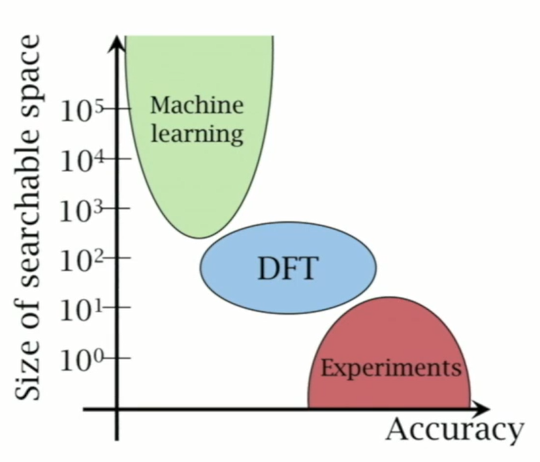
ML has the potential to fill the gap, enabling searches of large spaces of materials
Figure: Comparison of ML, DFT and Experiments on size of searchable space and accuracy. [7]
[7] Cubuk, Ekin D., Austin D. Sendek, and Evan J. Reed. "Screening billions of candidates for solid lithium-ion conductors: A transfer learning approach for small data." The Journal of chemical physics 150, no. 21 (2019): 214701.
14-09-2021
Notes:
so in our in our
landscape here of you know accuracy of a
scientific approach versus the size of
the searchable space so let's say like
the number of materials you can assess
in a given period of time
density functional Theory simulations
are a little bit less accurate but you
can automate this go through you know
hundreds of thousands machine learning
is going to be less accurate still but
orders of magnitude faster so you can
get through you know billions of of
candidate materials so if we want to
accelerate the development of
solid-state batteries we have to be
trial and error and we need a smarter
and a data-driven path forward

Slide 13
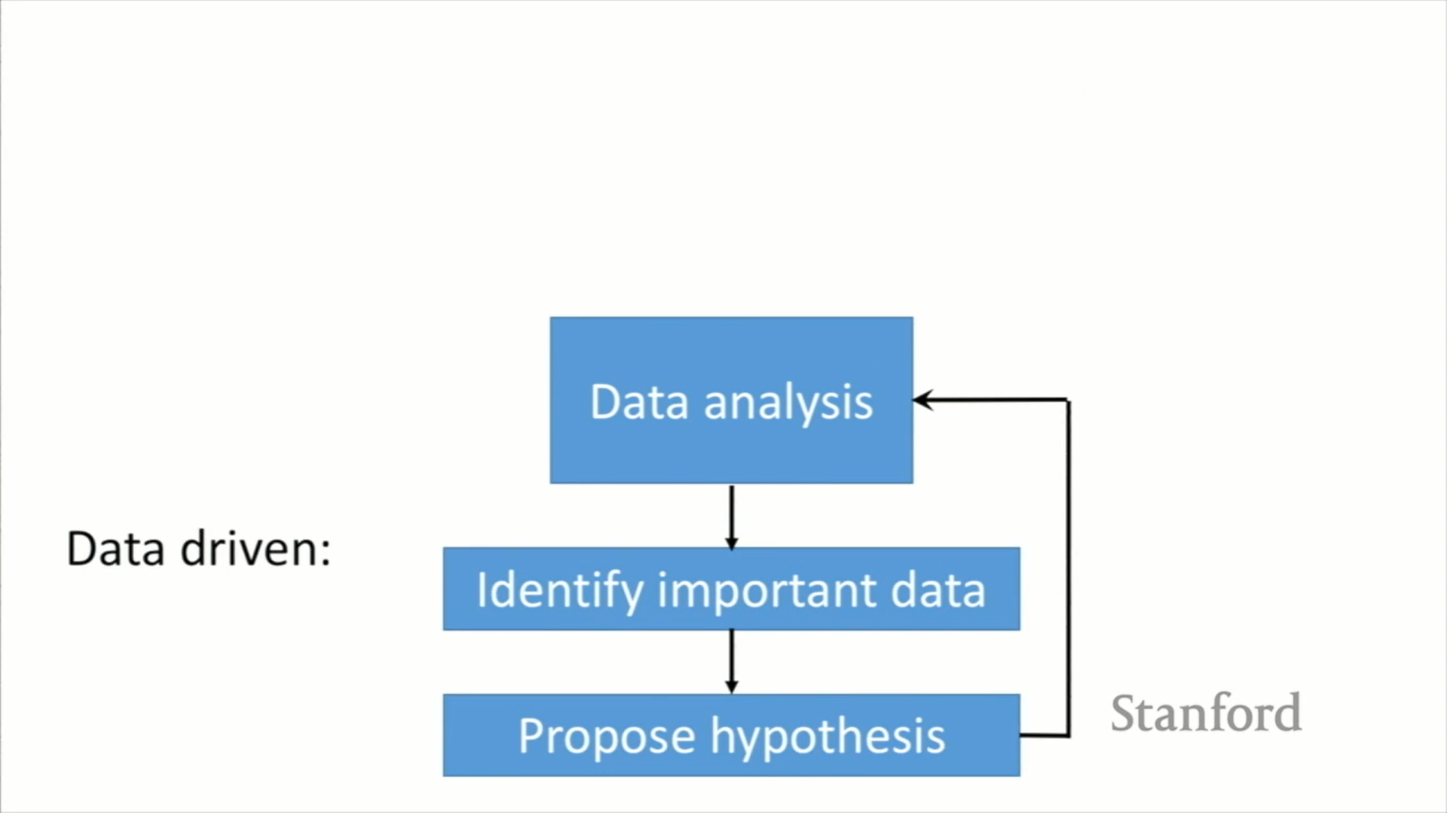
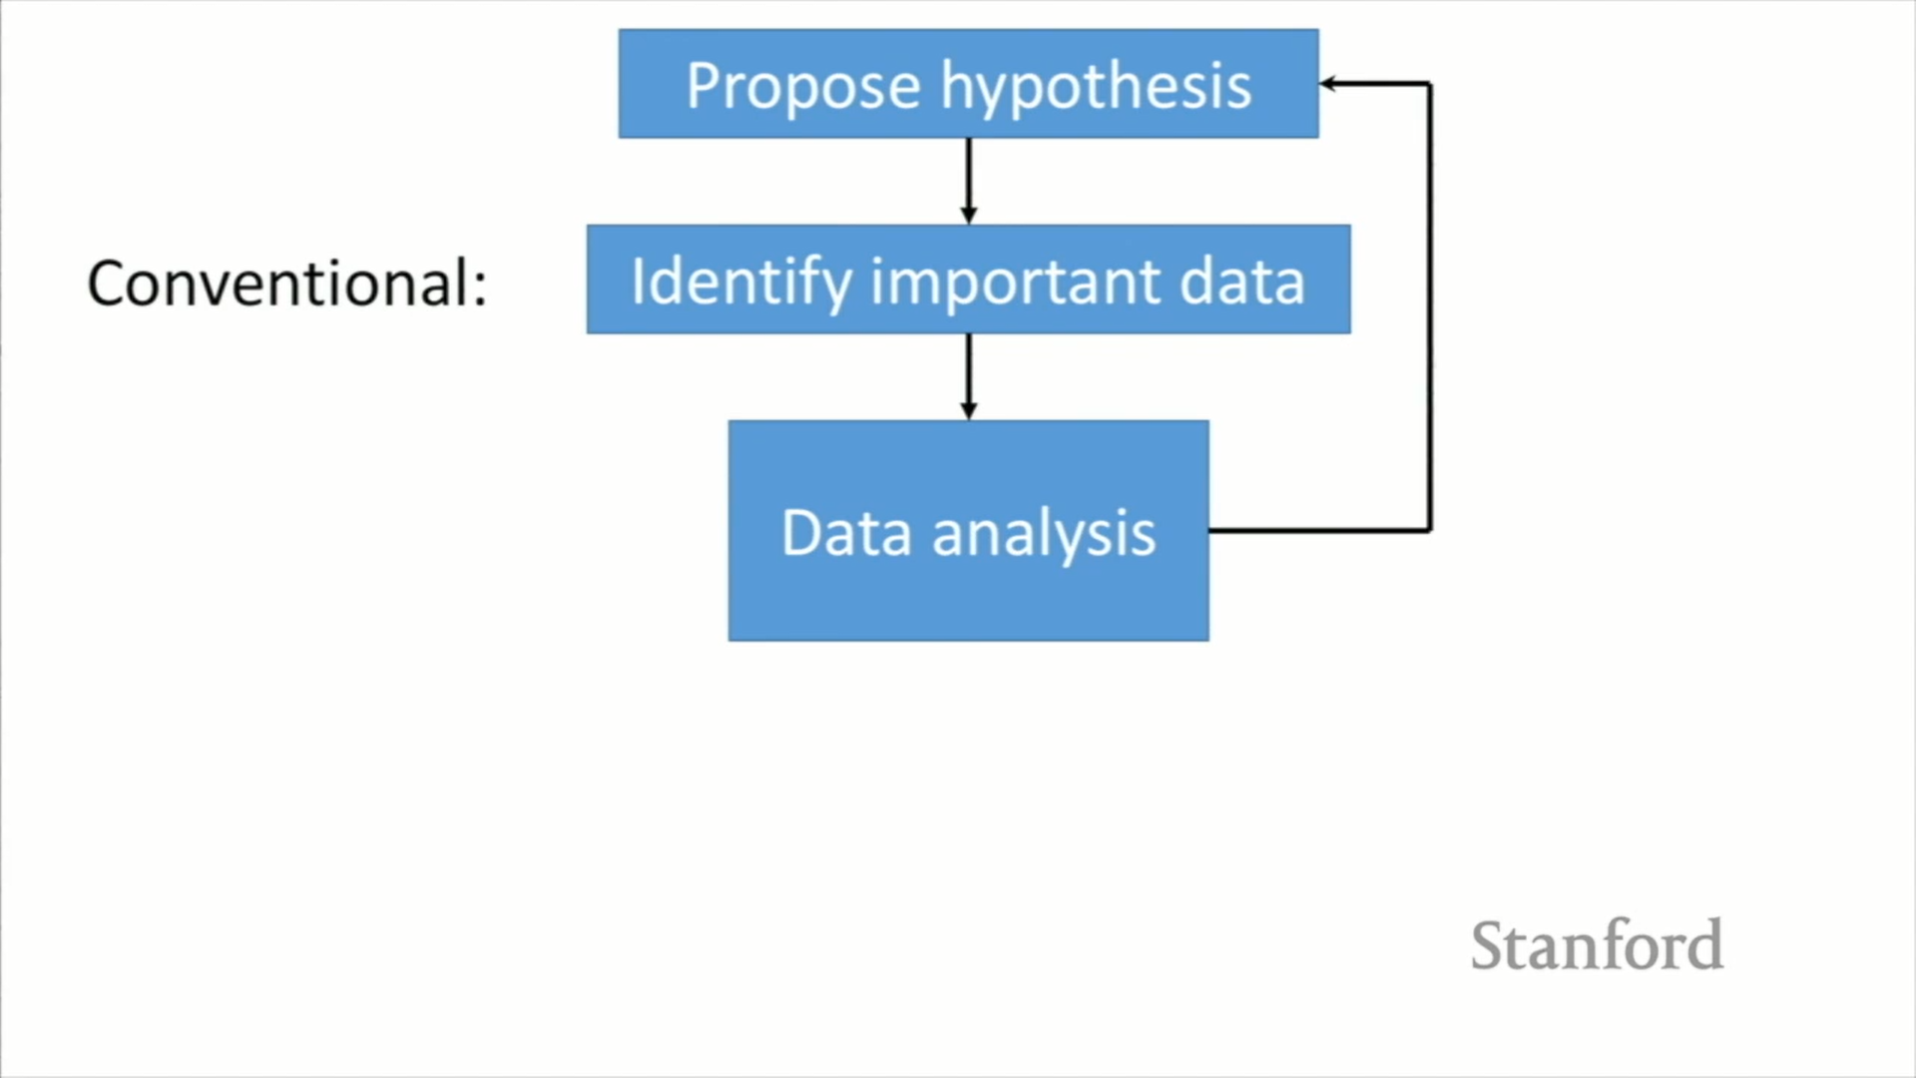
Process of model building
Figure: Difference between conventional and data-driven approach ^{[7]}
[7] Cubuk, Ekin D., Austin D. Sendek, and Evan J. Reed. "Screening billions of candidates for solid lithium-ion conductors: A transfer learning approach for small data." The Journal of chemical physics 150, no. 21 (2019): 214701.
14-09-2021
Notes:
so data
analysis is really central to any kind
of scientific endeavor and in a
conventional scientific method data
analysis usually comes at the end so we
propose a hypothesis on you know why
something is happening we go out and
we've identified the important data that
we need to validate the hypothesis we
analyze it and then we repeat the cycle
but what we're doing is we're really
turning this thing on its head so we
start with gathering a bunch of data and
then we identify the important data and
we let the hypotheses sort of fall out
of the data that we have so we're not
really going into it saying that we know
what causes connectivity we're hoping
that the data sort of tells us what that
is

Slide 14
40 experimental measurements of conductivity
No single feature has strong correlation with ionic conductivity across all the 40 materials.
Hence, they adopted a binary classification strategy with a 10^-4 S/cm boundary, motivated by engineering requirements .
Training set includes 11 “good” conductors, 29 “bad” conductors. [5]
[5] Sendek, Austin D., Qian Yang, Ekin D. Cubuk, Karel-Alexander N. Duerloo, Yi Cui, and Evan J. Reed. "Holistic computational structure screening of more than 12000 candidates for solid lithium-ion conductor materials." Energy & Environmental Science 10, no. 1 (2017): 306-320.
14-09-2021

Slide 15
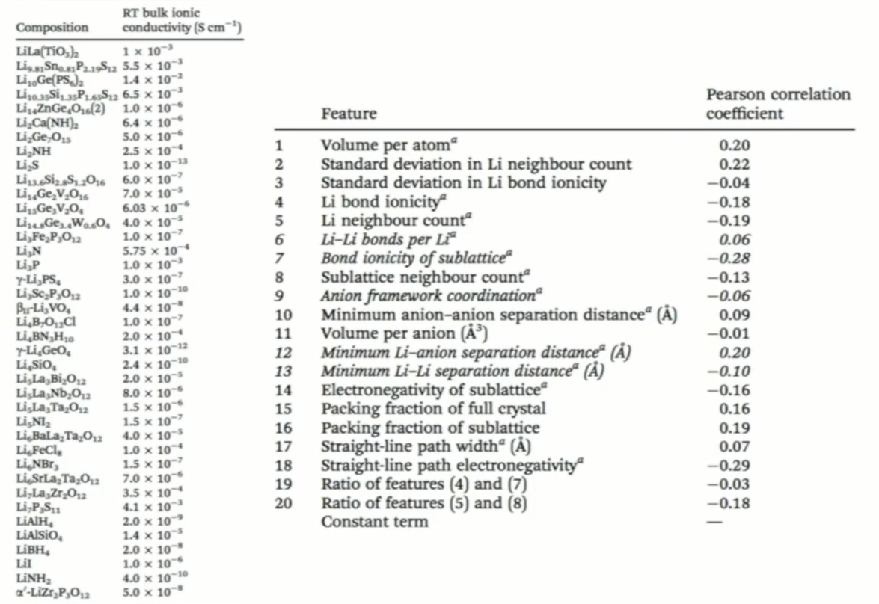
Figure: 40 experimental measurements of conductivity and 20 features for predicting ionic conductivity. ^{[5]}
[5] Sendek, Austin D., Qian Yang, Ekin D. Cubuk, Karel-Alexander N. Duerloo, Yi Cui, and Evan J. Reed. "Holistic computational structure screening of more than 12000 candidates for solid lithium-ion conductor materials." Energy & Environmental Science 10, no. 1 (2017): 306-320.
14-09-2021
Notes:
Experimental measurements of ionic conductivity at room temperature for 40 different materials are gathered and these are all crystalline materials and they have well-defined structures that have been characterized and so for all 40 of them, the researchers came up with 20 features which are essentially pieces of information that they think might have some bearing on predicting ionic conductivity. Some of them came from the literature, from things that people have proposed, some of them came from intuition.[5]
The first thing that they did was that they just computed all twenty of these for the forty materials and they looked at them one by one just to see which one predicts conductivity and the correlation coefficients are shown in figure 3 and we can see that they are all small. They are all less than plus or minus 0.3.
So out of their initial twenty guesses, none of them really were good predictors. So they have used an axiom in machine learning which is that if we have a bunch of weak learners or weak descriptors, we can put them together in a creative way that we can create a strong learner or a better predictor.[5] So even though there's no single feature with a strong correlation across this diverse set, we hope that we can creatively put these together in a way that gives us that predictive power.

Slide 16
Logistic Regression
It’s a classification algorithm, that is used where the response variable is categorical. The idea of Logistic Regression is to find a relationship between features and probability of particular outcome.
Maximum Likelihood Estimation is used to estimate regression coefficients.
There can be infinite sets of regression coefficients. The maximum likelihood estimate is that set of regression coefficients for which the probability of getting the data we have observed is maximum. [8]
[8] https://medium.com/data-science-group-iitr/logistic-regression-simplified-9b4efe801389
14-09-2021
Notes:
To move forward we have to choose a model that we want to use. A binary classifier model was chosen which just predicts essentially a yes or a no. So the training set was broken down into good conductors and bad conductors with a cut-off of 10-4. So that is the lowest we can have and still have it be considered a good electrolyte material. This splits this up into about 1/4 good conductors about 3/4 bad conductors. There are no conventions in this sort of space especially in machine learning with this small of a data set but after testing other models, this was the one that the researchers found worked the best

Slide 17
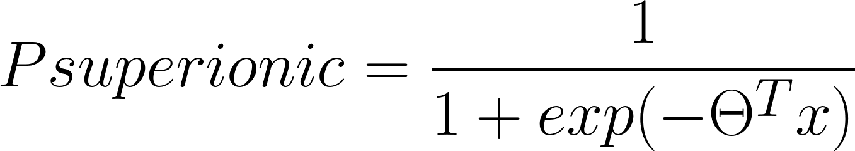
Logistic Regression
Assuming a logistic form as shown in Eqn. 1, we search for maximally predictive set of features:
(1)
Where 𝚹s are the regression coefficients.
[5] Sendek, Austin D., Qian Yang, Ekin D. Cubuk, Karel-Alexander N. Duerloo, Yi Cui, and Evan J. Reed. "Holistic computational structure screening of more than 12000 candidates for solid lithium-ion conductor materials." Energy & Environmental Science 10, no. 1 (2017): 306-320.
14-09-2021
Notes:
In the logistic regression, it has θ transpose x in the denominator. x's are the combination of features and the θs are the regression coefficients. So the question is now which of those 20 features would give us the best predictive model for that data that we're training it on.

Slide 18
Prediction of Superionic behaviour
20 candidate features
40 experimental data points
Find feature set that best reproduces the data under cross-validation
[5] Sendek, Austin D., Qian Yang, Ekin D. Cubuk, Karel-Alexander N. Duerloo, Yi Cui, and Evan J. Reed. "Holistic computational structure screening of more than 12000 candidates for solid lithium-ion conductor materials." Energy & Environmental Science 10, no. 1 (2017): 306-320.
14-09-2021
Notes:
We take the 20 candidate hypotheses and the 40 data points and then we want to find the best feature set we want to fit the data to. Having a small data set usually is bad because we can have problems with overfitting and it is harder to deal with. But one of the benefits is that with a small data set we can search the entire model space in a reasonable amount of time.

Slide 19
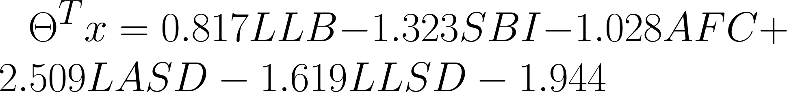
ML finds the best Li conduction model for this data set
(1)
(2)
Where LLB is Lithium-lithium bond number, SBI is Sublattice bond ionicity, AFC is Anion framework coordination, LASD is Li-anion separation distance and LLSD is Li-Li separation distance.
>1 week with DFT <1s with ML
[5] Sendek, Austin D., Qian Yang, Ekin D. Cubuk, Karel-Alexander N. Duerloo, Yi Cui, and Evan J. Reed. "Holistic computational structure screening of more than 12000 candidates for solid lithium-ion conductor materials." Energy & Environmental Science 10, no. 1 (2017): 306-320.
14-09-2021
Notes:
The hope is that this optimal model would give an accurate guess about 90% of the time. The model developed is shown in Eqn. 2.
Where LLB is Lithium-lithium bond number, SBI is Sublattice bond ionicity, AFC is Anion framework coordination, LASD is Li-anion separation distance and LLSD is Li-Li separation distance. These five features are easily interpreted in a material science context. This equation is based on five pieces of information and this takes, if we set it up an automated script, less than a second like a microsecond to compute, whereas it would have taken one week to get an estimate of conductivity with density functional theory simulations which use physics and have to solve the Schrodinger equation and simulate atoms. Hence, this is a huge speed improvement.

Slide 20
Holistic structure screening of > 12,000 candidates
Screening is done on features like:
High stability against oxidation
High stability against reduction
Low electronic conductivity
High phase stability
Low cost
High earth abundance
All Li-containing materials: >12,000
All requirements except ionic conductivity: 317
All requirements: 21^{[5]}
[5] Sendek, Austin D., Qian Yang, Ekin D. Cubuk, Karel-Alexander N. Duerloo, Yi Cui, and Evan J. Reed. "Holistic computational structure screening of more than 12000 candidates for solid lithium-ion conductor materials." Energy & Environmental Science 10, no. 1 (2017): 306-320.
14-09-2021
Notes:
so now that we have this
model which is about a million times
faster than the incumbent methods that
is so much faster it will allow us to
screen every known candidate material
out there and we found over 12,000 of
them in the online database of the
materials project which is curated at
Lawrence Livermore Berkeley
National Lab and we started screening
through them and we also included six
extra screening metrics which were these
weren't built from machine learning
these were built on kind of simple
heuristics and information where we
could get it and these are here's the
pieces of information these are all kind
of you know different parts of that that
graph from arpa-e that I showed at the
beginning so we're a conductivity isn't
all the matters here are six other
things that that we can use to help our
screening so when we take these twelve
thousand candidate materials we first
applied these six don't don't think
about connectivity yet just apply these
six and then actually gets it down
significantly to a little bit over 300
materials
still too many for us to do 300
experiments or 300 simulations so this
is where we take our connectivity
predictor apply it to those 300 and
we're able to get it down to 21 and lo
and behold we're able to do the first
multi property screening of all known
lithium containing compounds
for solid electrolyte materials because
we have this connectivity model which is
so much faster than than what what we
had before

Slide 21
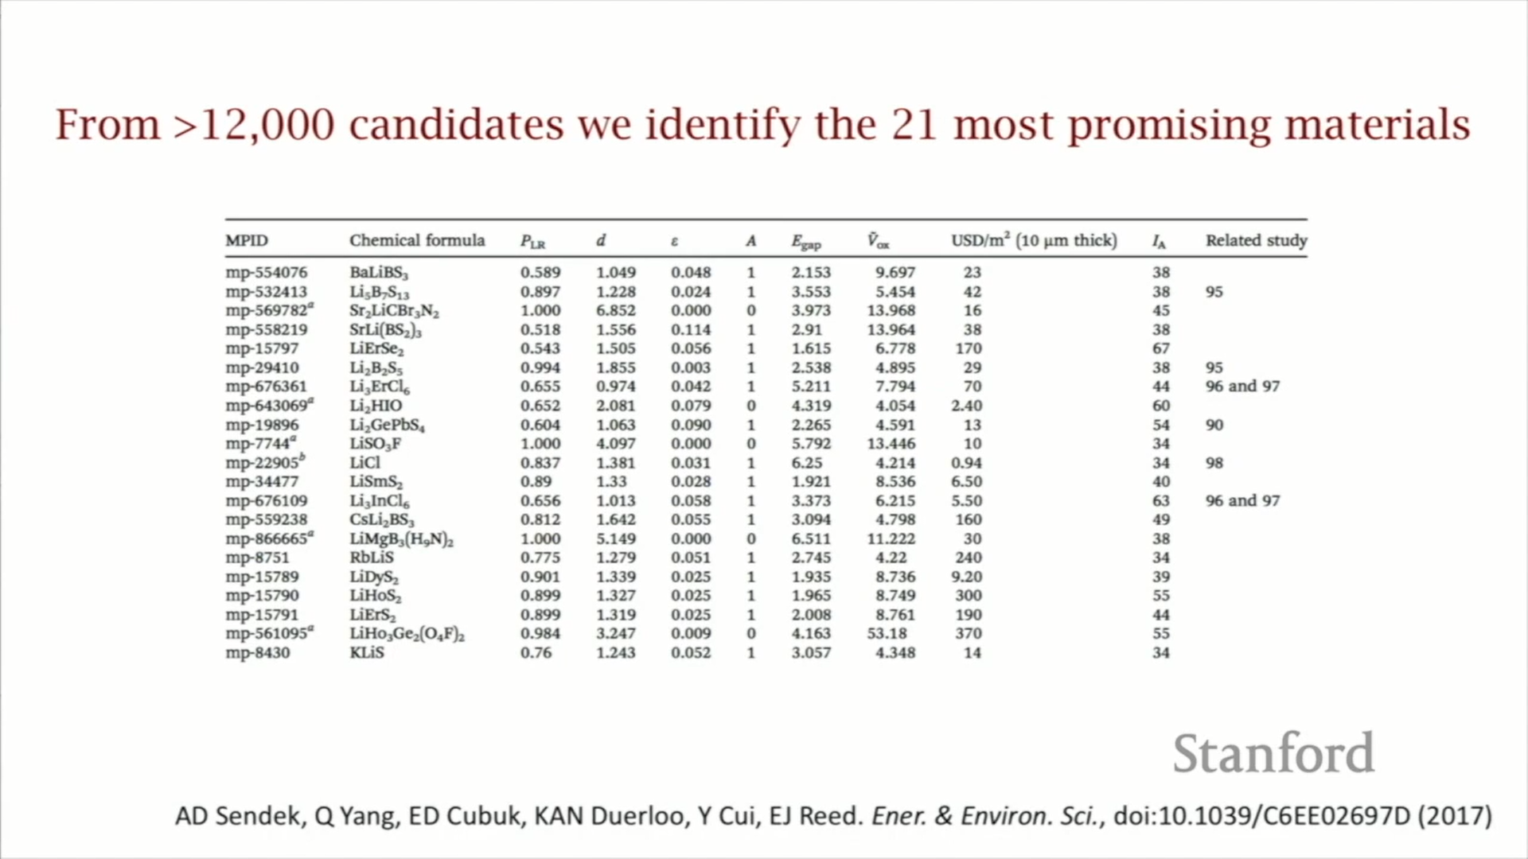
From >12,000 candidates we identify the 21 most promising materials
Figure: 21 most promising materials ^{[5]}
[5] Sendek, Austin D., Qian Yang, Ekin D. Cubuk, Karel-Alexander N. Duerloo, Yi Cui, and Evan J. Reed. "Holistic computational structure screening of more than 12000 candidates for solid lithium-ion conductor materials." Energy & Environmental Science 10, no. 1 (2017): 306-320.
14-09-2021

Slide 22
10 new superionic conductors were discovered
Unit cell
DFT MD @ high T
Li MDS @ high T
Li conductivity @ RT
[5] Sendek, Austin D., Qian Yang, Ekin D. Cubuk, Karel-Alexander N. Duerloo, Yi Cui, and Evan J. Reed. "Holistic computational structure screening of more than 12000 candidates for solid lithium-ion conductor materials." Energy & Environmental Science 10, no. 1 (2017): 306-320.
14-09-2021
Notes:
Physics based model testing was done for all those 21 materials shortlisted.
We
also have to seem like these at high
temperature because connectivity is is
just so slow at room
temperature that will never see it so we
could simulate it for you know for a
year or two and at room temperature we
might see some motion we might not so
really the standard way of doing this is
doing at a higher temperatures and then
extrapolating down to room temperature

Slide 23
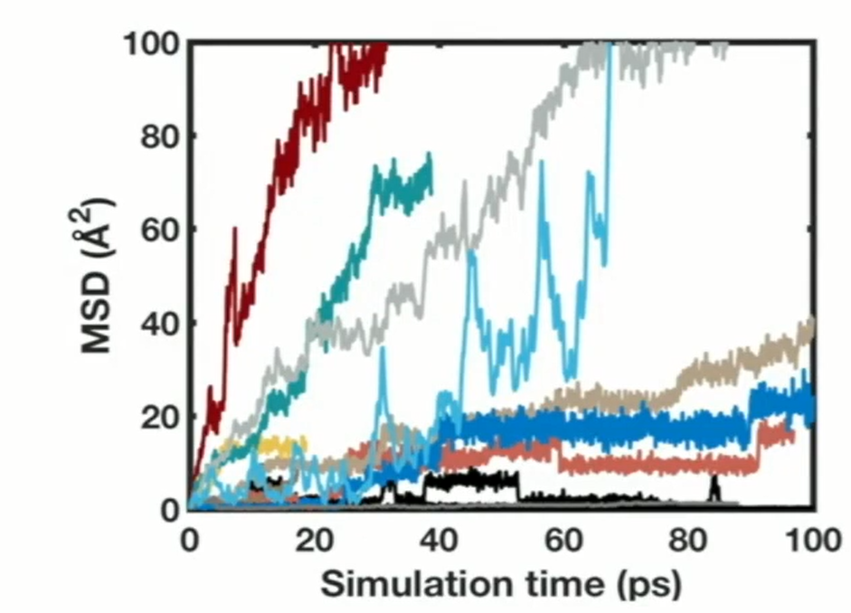
50% hit rate
Figure: Mean squared displacement plot of Lithium migration for 10 materials. ^{[5]}
[5] Sendek, Austin D., Qian Yang, Ekin D. Cubuk, Karel-Alexander N. Duerloo, Yi Cui, and Evan J. Reed. "Holistic computational structure screening of more than 12000 candidates for solid lithium-ion conductor materials." Energy & Environmental Science 10, no. 1 (2017): 306-320.
14-09-2021
Notes:
so the this
is a this is a MSD a mean squared
displacement plot this is a common way
of showing this essentially this is
tracking how far lithium migrates in
time in these different materials so
every different color is a different
material and you know this is this is
how far lithium is moving in these these
simulation times this is really short
we're talking on the order of Pico
seconds these these physics based codes
are really that slow that we have to
operate on this time scale but the
slopes of these curves are what tell us
about conductivity which is our original
Metric
so of these these materials that we have
we can kind of break them down into
three categories so we have four
materials here which are we find are
really on par with the best known
materials out there they're about 10 to
minus 2 Siemens per centimeter which is
really exciting and we have this kind of
you know still exciting is 10 to the
minus 4 this is near what we said our
cutoff of good materials was but not
quite as exciting but but you know still
good predictions and then we get several
materials that don't really show any
motion at all and so I'm taking together
this gives us this 50% hit rate for for
the modeler success rate so now that we
know that then the next question is how
do we judge a 50% accurate model you
know most of us don't want to be
accurate and 50% of the things that we
do but the way to judge this is really
to compare it to the incumbent methods
how much how much improvement is this
model offering us over what we would
expect to do if we didn't have this
model and a lot of times that really
comes down to comes down to
random guessing so is this is 50% better
than random guessing and if so you know
how much better

Slide 24
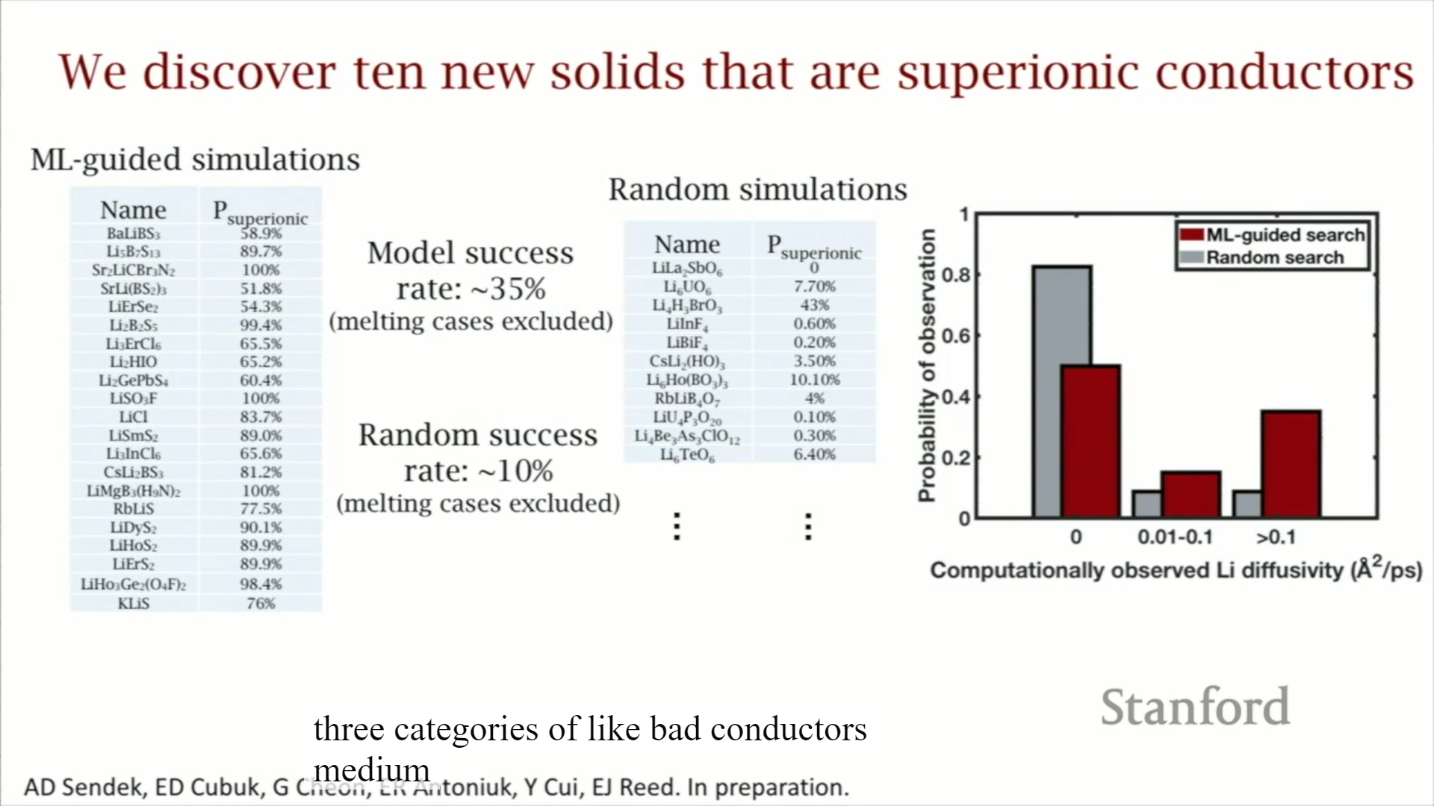
Comparison
Figure: ML - guided simulations with model success rate: ~35 to 50% ^{[5]}
[5] Sendek, Austin D., Qian Yang, Ekin D. Cubuk, Karel-Alexander N. Duerloo, Yi Cui, and Evan J. Reed. "Holistic computational structure screening of more than 12000 candidates for solid lithium-ion conductor materials." Energy & Environmental Science 10, no. 1 (2017): 306-320.
14-09-2021
Notes:
hat's like that's a
very quantitative question which is
really difficult to answer without
actually doing trial and error there's
not really a way of to know what trial
and error is going to give you until you
do it
so we reluctantly had to just do a bunch
of trial and error
in order to get some statistics here so
we have this this list of materials that
the machine learning told us to simulate
we started simulating them there's some
subtleties of the of how we count
successes here so we'll say it's the
success rates between 35 to 50 percent
it had it has to do with things with
melting etc not super important

Slide 25
Comparison
Figure: Random simulations with success rate: ~10% ^{[5]}
[5] Sendek, Austin D., Qian Yang, Ekin D. Cubuk, Karel-Alexander N. Duerloo, Yi Cui, and Evan J. Reed. "Holistic computational structure screening of more than 12000 candidates for solid lithium-ion conductor materials." Energy & Environmental Science 10, no. 1 (2017): 306-320.
14-09-2021
Notes:
but then
we started doing the exact same
procedure but we were just simulating
materials that were chosen at random and
what we found in that case was that the
success rate was about 10% so you can
see right away that there's going from
random to this machine learning driven
for you have about a three three to five
times depending on how you count this
improvement in the rate of successes of
our of our effort

Slide 26
Comparison
Figure: Comparison of ML guided search and Random search. ^{[6]}
Learning from only 40 data points = 3x improvement over guess work
[6] Sendek, Austin D., Ekin D. Cubuk, Evan R. Antoniuk, Gowoon Cheon, Yi Cui, and Evan J. Reed. "Machine learning-assisted discovery of many new solid li-ion conducting materials." arXiv preprint arXiv:1808.02470 (2018).
14-09-2021
Notes:
this histogram
shows kind of demonstrates that we have
three categories of like bad conductors
medium conductors good conductors the
gray bars are what we find with random
searches and then the red bars are what
we find with machine learning guided
searches so you can see you get about
half the duds that we had in the random
search and we get a probably four times
more really great conductors and when
doing this so I think you know there's
definitely a tangible you know
undeniable improvement that's offered
here by machine learning and I think
it's really important just to emphasize
that this 3x improvement guess where it
came from a model that was trained on 40
data points and if you were to ask
someone say from Google or from Facebook
what 40 data points means they would
probably tell you it's it's you know
zero point zero statistically speaking
from their perspective this is basically
no data at all so I think it's it's just
worth pointing out that even small
amounts of data if you sort of work with
it the right way can give you really
tangible improvements in the way that
that you discover materials that you
search through space

Slide 27
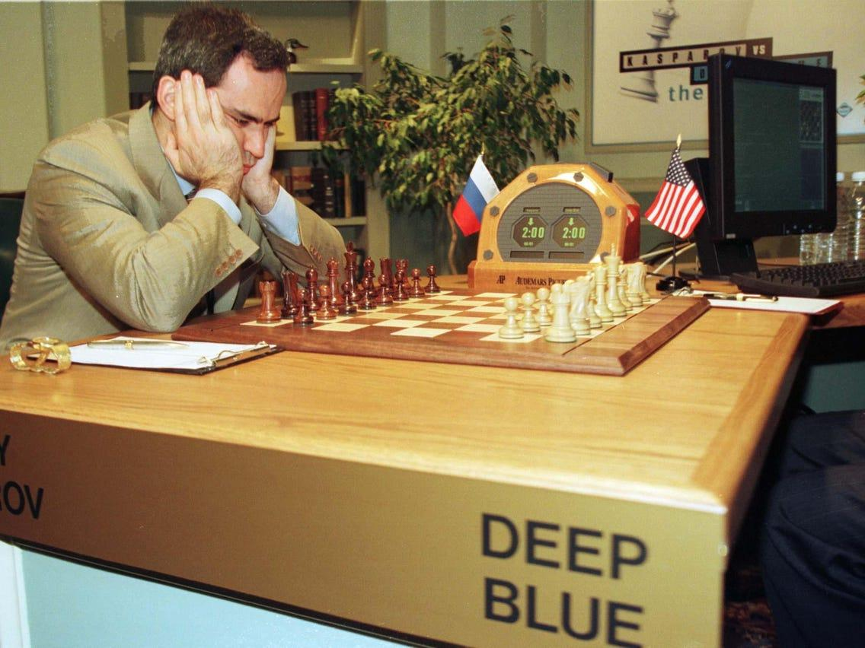
Scientists are not truly guessing at random but can they beat the machine?
Image: Garry Kasparov VS Deep Blue ^{[9]}
[9] https://www.businessinsider.in/tech/news/the-chess-grandmaster-who-was-beaten-by-a-computer-predicts-that-ai-will-destroy-most-jobs/articleshow/74288210.cms
14-09-2021
Notes:
scientists are hopeful e better than
random they're not totally randomly
guessing so how does this compare not to
a random guess but to to a scientist
that's maybe trained in in this field so
this is sort of the Garry Kasparov
versus deep blue analogy for material
science

Slide 28
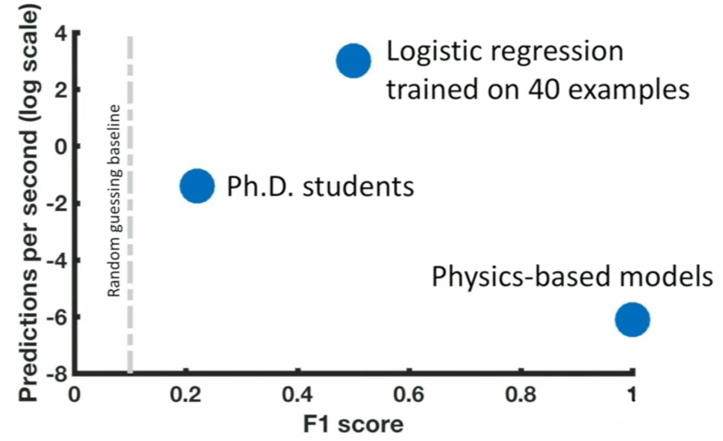
Algorithm outperforms humans in accuracy and speed
Figure: Performance of PhD students, ML Model and Physics-based models on predicting good candidate material^{[6]}
[6] Sendek, Austin D., Ekin D. Cubuk, Evan R. Antoniuk, Gowoon Cheon, Yi Cui, and Evan J. Reed. "Machine learning-assisted discovery of many new solid li-ion conducting materials." arXiv preprint arXiv:1808.02470 (2018).
14-09-2021
Notes:
so this is what stanford did so we
took a list of 25 materials and we gave
it to a group of PhD students here in
the material science department that are
trained in electrochemistry essentially
and then we gave that same list of
materials to the code to the machine
learning algorithm and we said find us
the the good lithium ion conductors in
this batch of materials and so we have
two axes here so this is basically
accuracy of the predictions and this is
speed so here on the Left this is the
random guessing baseline so that there's
about 10% of those materials
are our good conductors that's what we
would expect to see if you were guessing
at random and the PhD students double
random guessing basically they have an
accuracy that's twice as high
I don't know but they're definitely
beating random guessing by a factor of
two
but then the logistic regression model
trained on 40 examples beats random
guessing by a factor of about five and
beats the students by about two to three
times and if that's not good enough we
have this is a log scale here it takes
about a million times or it's a million
times faster for the machine learning
model to make those predictions so
students would take about a minute and
the computer takes as I said live less
than a second and for reference here we
have these physics based models which
are used to validate the predictions we
assume these are 100% accurate so that's
why they're up here way on the right but
they are incredibly slow so each each
material takes several weeks to to get a
good validation for so this is our as a
sort of our Bermuda Triangle of machine
learning and students guessing materials
F1 score
The F1 Score is the 2*((precision*recall)/(precision+recall)). It is also called the F Score or the F Measure. Put another way, the F1 score conveys the balance between the precision and the recall.

Slide 29
When is it appropriate to apply machine learning to a materials problem?
It offers several times more accurate screening than trial-and-error.
But is likely less accurate than physics-based models.
Many orders of magnitude faster than human guessing or experimental methods . [5]
[5] Sendek, Austin D., Qian Yang, Ekin D. Cubuk, Karel-Alexander N. Duerloo, Yi Cui, and Evan J. Reed. "Holistic computational structure screening of more than 12000 candidates for solid lithium-ion conductor materials." Energy & Environmental Science 10, no. 1 (2017): 306-320.
14-09-2021
Notes:
so machine learning offers
several times or guessing that several
times more accurate than trial and error
and potentially also then human guessing
it's less likely in general to be it's
it's less it's likely less accurate in
general than physics based models but
it's many times faster than that both of
these approaches so you know we often
have have people that come to us and ask
sort of when when is it appropriate to
apply machine learning to a materials
problem and I think this is this is kind
of the answer if you're working in a
domain where it takes you a very long
time to get a data point so you know
it's you you really need improvements in
speed and you really just want to be
able to be
you know to be several times more
accurate than trial and error so if
you're doing trial and error then that's
great that's sort of the the niche I
think that machine learning enhanced
material science is well suited to fil

Slide 30
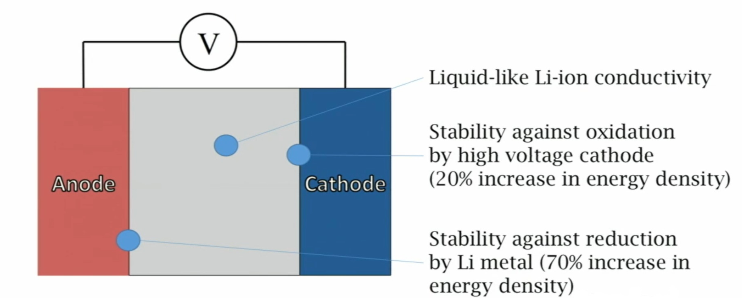
Simultaneous optimization of conductivity and stability is tough
Figure: Single solid electrolyte battery schematic ^{[6]}
[6] Sendek, Austin D., Ekin D. Cubuk, Evan R. Antoniuk, Gowoon Cheon, Yi Cui, and Evan J. Reed. "Machine learning-assisted discovery of many new solid li-ion conducting materials." arXiv preprint arXiv:1808.02470 (2018).
14-09-2021
Notes:
etting good iron conductors
is hard enough but getting good ion
conductors that are electrochemical
state
below for a wide range of voltages is
even harder
so here's coming back to our
schematic of the battery so here's our
electrolyte and we're basically asking
three demands of it if we move beyond
connectivity so we we know that we need
a good ion conductor but we also need it
to be stable against oxidation at the
cathode so here is touching the cathode
and at this interface it tends to be
oxidized and if it becomes oxidized then
usually you know four through one way or
another it tends to break down so we'd
like to avoid oxidation there
and that the anode is touching this
really low voltage surface and it will
tend to be reduced so can we find you
basically we're looking for a material
that can satisfy all of these at once is
in as I said that's a it's a very tough
optimization to do one thing that has
been proposed is a way of making this a
little bit easier is

Slide 31
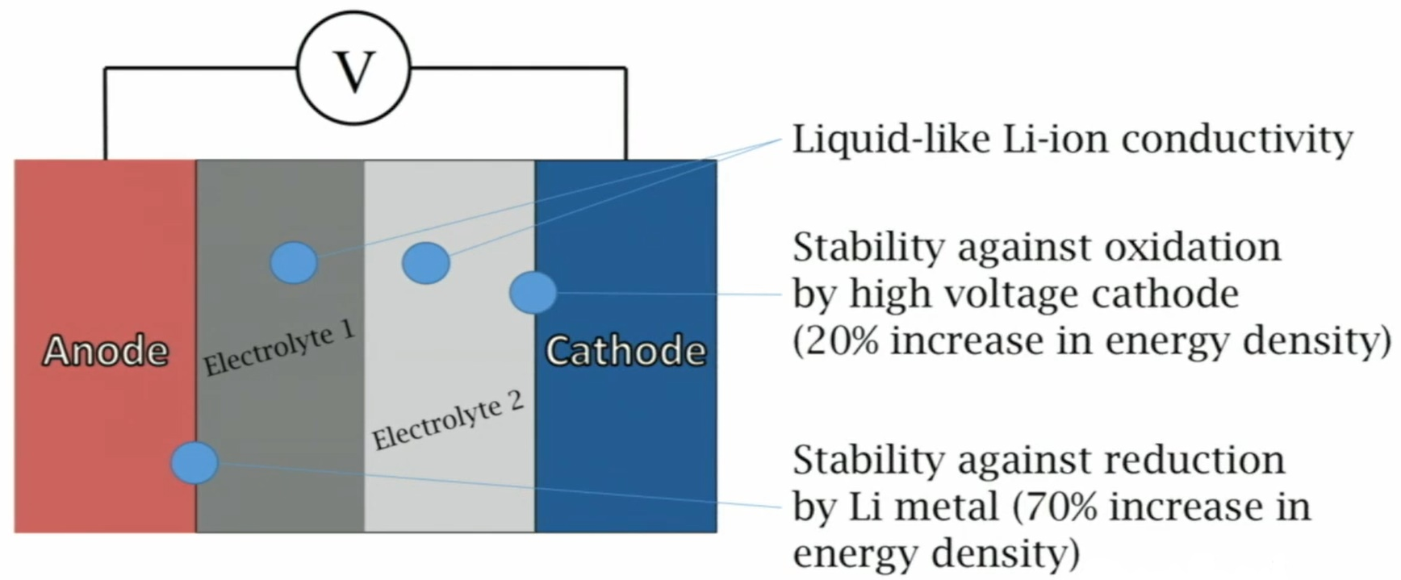
Simultaneous optimization of conductivity and stability is tough
Figure: Double solid electrolyte battery schematic ^{[6]}
[6] Sendek, Austin D., Ekin D. Cubuk, Evan R. Antoniuk, Gowoon Cheon, Yi Cui, and Evan J. Reed. "Machine learning-assisted discovery of many new solid li-ion conducting materials." arXiv preprint arXiv:1808.02470 (2018).
14-09-2021
Notes:
to split the
electrolyte up into two electrolytes now
both of them need to have good ion
conductivity but electrolyte one is
touching the anode and not the cathode
so it only needs to be stable against
traduction electrolyte two is only
touching the cathode and not the anode
so it only needs to be stable against
oxidation so you you can kind of use the
demands on these materials a little bit
more by doing that but of course you
introduce you know additional
difficulties manufacturing these things
is really hard to get to materials to
stack right on top of each other with
minimal defects and you know interfacial
resistance and all that kind of stuff so
it's not really clear this is this has
been something that's more recently
thought about and it's not really clear
I think which strategy is better so
these are these are the sorts of things
that that we're thinking about

Slide 32
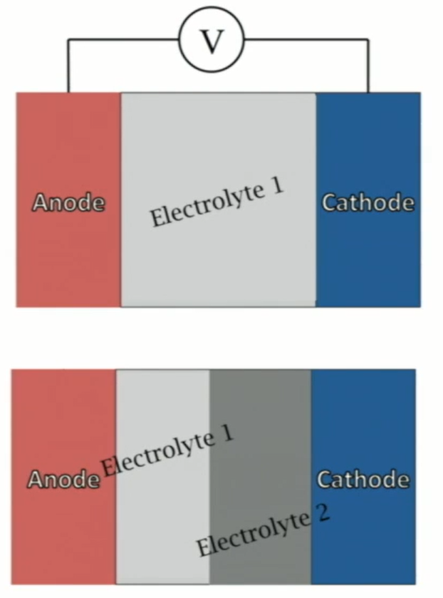
Quantifying the likelihood of success for 1 vs 2 electrolytes
P(success) = P(one material meets all requirements)
= 0.06%
P(success) = P(one material stable to oxidation) x P(one material stable to reduction)
= 90% x 10% = 9%
Figure: Schematic of single and double solid electrolyte LIB ^{[6]}
150X!
[6] Sendek, Austin D., Ekin D. Cubuk, Evan R. Antoniuk, Gowoon Cheon, Yi Cui, and Evan J. Reed. "Machine learning-assisted discovery of many new solid li-ion conducting materials." arXiv preprint arXiv:1808.02470 (2018).
14-09-2021
Notes:
so coming back to
this 1 versus 2 electrolyte system if I
want to do this if I want to build this
lithium metal high voltage you know
wonder material battery I can do with
one electrolyte or I can do it with two
if I do with one the probability of
success here is the probability that at
least from the materials discovery
perspective that I can find one material
that satisfies all the requirements but
if I do it with two my probability of
success is the probability that I find
one good conductor that is stable
against oxidation times the probability
that I find a good ion conductor that's
stable against reduction and we now have
quantitative numbers to do this
calculation so for the two electrolyte
case we find that it's the likelihood of
of doing the first criteria is about 90%
there's a lot of good materials for that
better for fluoride based and the
likelihood or the second one is 10% so
the joint probability here is 9% so that
seems pretty good and the the the
reduction stable material is a nitride
so it's basically this 9% corresponds to
a fluoride and a nitride based dual
electrolyte but if we want 1 electrolyte
we don't get to mix a fluoride with with
the nitride we have to choose one
material we have to find one material
from one family that is likely to to
meet all these criteria and the
chlorides are the the most likely we
find the most likely material family to
do that but there are incredibly
unlikely
there are about 0.06 percent and that's
the best the most likely of all of the
options that we have and so we can see
that you know in going from a 1 to 2
electrolyte system we're a 150 times
more likely to discover good materials
for this purpose so you know there are
there are certainly more there's more to
this puzzle than just the the materials
like I said we have to think about
processing we have to think about all
sorts of stuff but the first step is you
have to find good materials for it and
this is a this is a quantitative roadmap
that says you know your your 150 times
more likely to find success if you start
searching for this architecture then if
you do this one and just to make that

Slide 33
Conclusion
Model is 3x better than random guessing. [5]
Holistic screening of all known Li containing solids and discovery of several new superionic conducting structures is done.
Identification of many exciting new materials for further development was done.
These rapid models enable high-level insights, including new evidence that Li-metal batteries may need two electrolytes instead of one.
[5] Sendek, Austin D., Qian Yang, Ekin D. Cubuk, Karel-Alexander N. Duerloo, Yi Cui, and Evan J. Reed. "Holistic computational structure screening of more than 12000 candidates for solid lithium-ion conductor materials." Energy & Environmental Science 10, no. 1 (2017): 306-320.
14-09-2021
Notes:
let me sum up on on these
pieces of work so we we deploy machine
learning to enable the first holistic
screening of all known lithium
containing compounds about a million
times faster than random guessing and a million times faster than
that state of the art and that gives us
several new materials for for
development and also can give us some of
these high-level insights on different
strategies and how likely they are to
succeed that are really difficult to get
from physics based approaches

Slide 34
40 data points = 3x improvement
Imagine what we can do with 100 or 500?
[5] Sendek, Austin D., Qian Yang, Ekin D. Cubuk, Karel-Alexander N. Duerloo, Yi Cui, and Evan J. Reed. "Holistic computational structure screening of more than 12000 candidates for solid lithium-ion conductor materials." Energy & Environmental Science 10, no. 1 (2017): 306-320.
14-09-2021
Notes:
it's really exciting to
think about what 500 data points would
be able to get us or what a thousand
data points would be able to
if if 40 can already get us this much so

Slide 35
Data driven future/Future scope
Demand for clean energy will increase
Computing power will increase.
The amount of materials data will increase.
Full batteries will be designed more effectively and efficiently with machine learning. [5]
This approach is very general and will accelerate efforts in solar, electronics and more!
[5] Sendek, Austin D., Qian Yang, Ekin D. Cubuk, Karel-Alexander N. Duerloo, Yi Cui, and Evan J. Reed. "Holistic computational structure screening of more than 12000 candidates for solid lithium-ion conductor materials." Energy & Environmental Science 10, no. 1 (2017): 306-320.
14-09-2021
Notes:
we know for sure that that the demand
for clean energy is going to increase we
know for sure that computing power is
going to increase we know for sure that
the amount of materials data is going to
increase and what we believe is that
these the small amounts of data can be
really important they can drive
significant improvements I think
eventually batteries you know full
battery architectures will be able to be
designed this way from really from from
nothing or just from data rather than a
really extensive trial and error
searches in the lab and you know this
approach is also very general so it
doesn't have to be it stuck to batteries
it can it can it can accelerate efforts
in solar and catalysis immunes North
Cobb has been doing some great work in
this vein on catalysis here at Stanford
and you know electronics there's a
there's a really exciting future in in
store for these approaches and applying
them to the energy sphere

Slide 36
References
https://www.citroen.in/
https://www.massnetcomms.org/software-to-simplify-solar-farm-design/
https://www.ga-asi.com/remotely-piloted-aircraft/mq-9a
https://www.apple.com/in/
Sendek, Austin D., Qian Yang, Ekin D. Cubuk, Karel-Alexander N. Duerloo, Yi Cui, and Evan J. Reed. "Holistic computational structure screening of more than 12000 candidates for solid lithium-ion conductor materials." Energy & Environmental Science 10, no. 1 (2017): 306-320.
Sendek, Austin D., Ekin D. Cubuk, Evan R. Antoniuk, Gowoon Cheon, Yi Cui, and Evan J. Reed. "Machine learning-assisted discovery of many new solid li-ion conducting materials." arXiv preprint arXiv:1808.02470 (2018).
Cubuk, Ekin D., Austin D. Sendek, and Evan J. Reed. "Screening billions of candidates for solid lithium-ion conductors: A transfer learning approach for small data." The Journal of chemical physics 150, no. 21 (2019): 214701.
14-09-2021

Slide 37
References
https://medium.com/data-science-group-iitr/logistic-regression-simplified-9b4efe801389
https://www.businessinsider.in/tech/news/the-chess-grandmaster-who-was-beaten-by-a-computer-predicts-that-ai-will-destroy-most-jobs/articleshow/74288210.cms
Jordan, Michael I., and Tom M. Mitchell. "Machine learning: Trends, perspectives, and prospects." Science 349, no. 6245 (2015): 255-260.
Ceder, G., and K. Persson. "The materials project: A materials genome approach." DOE Data Explorer, http://www. osti. gov/dataexplorer/biblio/1077798.[2016-08-28] (2010).
Huggins, Robert A. "Recent results on lithium ion conductors." In International Symposium on Solid Ionic and Ionic-Electronic Conductors, pp. 773-781. Pergamon, 1977.
Kamaya, Noriaki, Kenji Homma, Yuichiro Yamakawa, Masaaki Hirayama, Ryoji Kanno, Masao Yonemura, Takashi Kamiyama et al. "A lithium superionic conductor." Nature materials 10, no. 9 (2011): 682-686.
14-09-2021

Slide 38
Thank you.

